Slide 1


LLM Reading Group 2:
Vision Transformers
Presented by
Bassel Al Omari

Slide 2
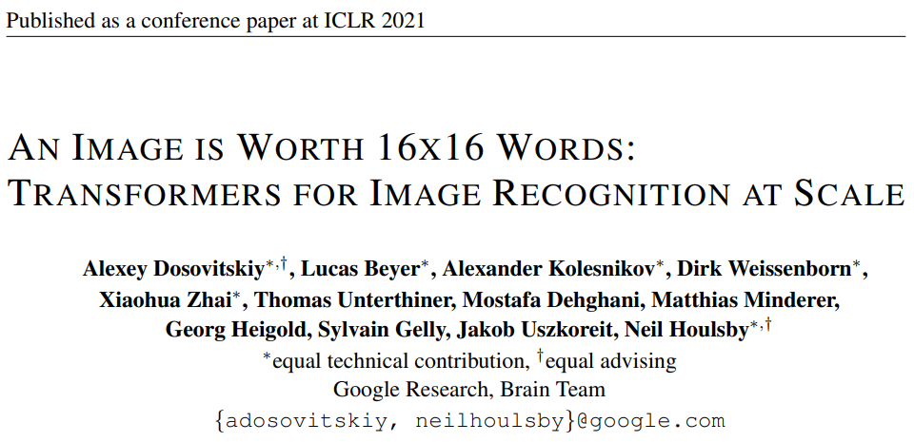
Link to the paper

Slide 3

Context
Convolutional Neural Nets
The standard ML architecture for visual data
Relies on a set of filters which scan the image and extract important features

Slide 4
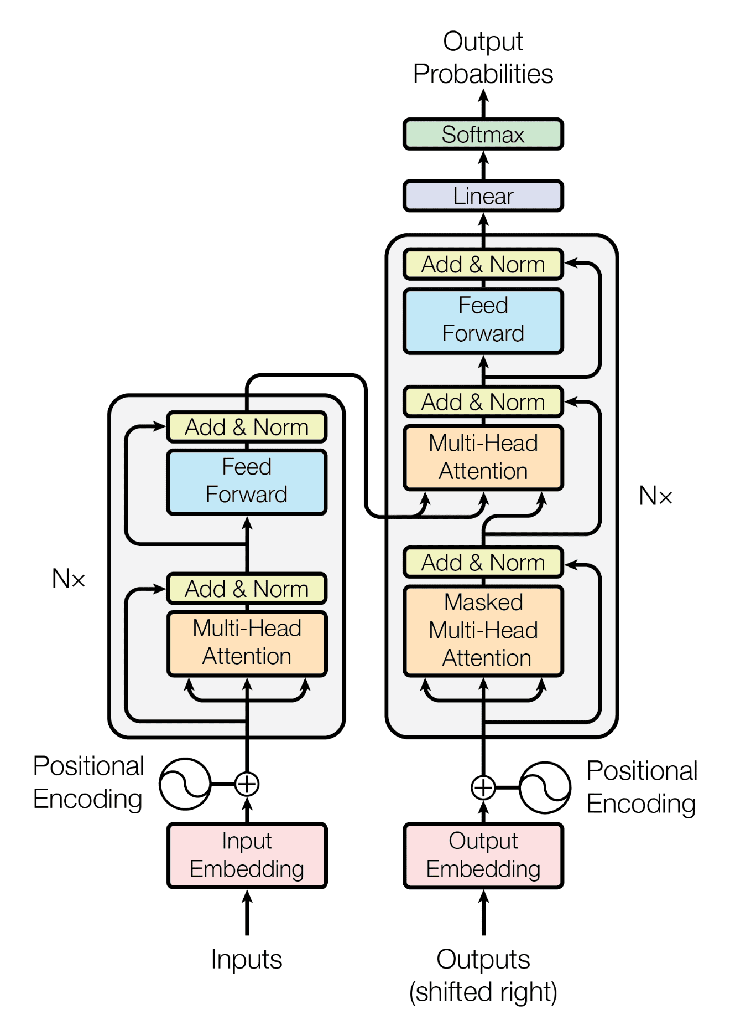

Context
Transformers
Reliant on Self-Attention Mechanism
Mainly used for sequential tasks and NLP
RNN Killers by their parallelizable nature (Also CNN killers?)

Slide 5
Naive Self-Attention on Images
Self Attention involves calculating the attention score between each pair of tokens in an input: O(n²) operation
Naive Attempt:
Treat each pixel as a token
Calculate attention scores between pixel pairs
For n ✖ n images this becomes an O(n⁴) operation
Very expensive for modern images
black dogs and red cats
black ➡ black dogs and red cats
dogs ➡ black dogs and red cats
and ➡ black dogs and red cats
red ➡ black dogs and red cats
cats ➡ black dogs and red cats

Slide 6
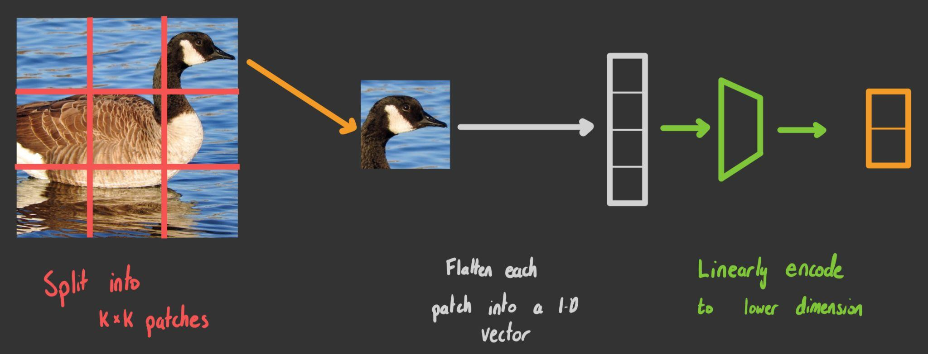
Flattened Patches
Split image into smaller k ✖ k
patches
Flatten each patch into a 1-D vector
Linearly encode to lower dimension

Slide 7
Implementation Details
Positional Embedding
Adds information about patch position
The positional embedding calculated based on only the 1-D position
Positional embedding isn’t a fixed function but is learned by transformer
Classification Token
Another learnable [class] vector is added with the other patches
The transformers output corresponding to this token is fed into the classifier MLP
1
2
3
4
5
6
7
8
9

Slide 8
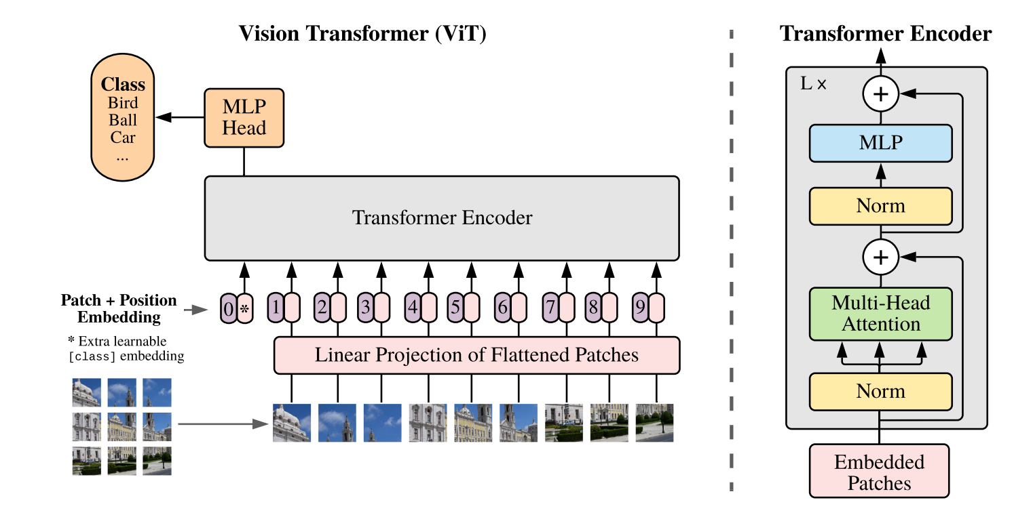
Overall Structure

Slide 9
Fine-tuning Modifications
Model is initially trained on Google’s in-house 300 million image dataset
When fine-tuning
Replace the original classifier head
Replace the positional embedding with another one based on the 2-D position of the patch
1 - 1
1 - 2
1 - 3
2 - 1
2 - 2
2 - 3
3 - 1
3 - 2
3 - 3

Slide 10
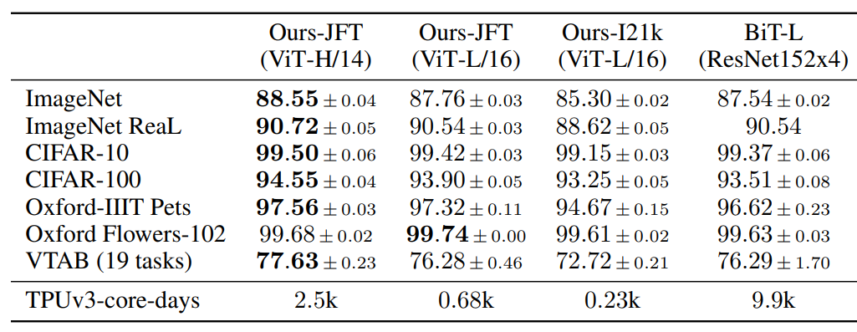
Results
Performs worse than CNN-based ResNets when trained on less data
Performs better when trained on huge datasets
Scales well

Slide 11
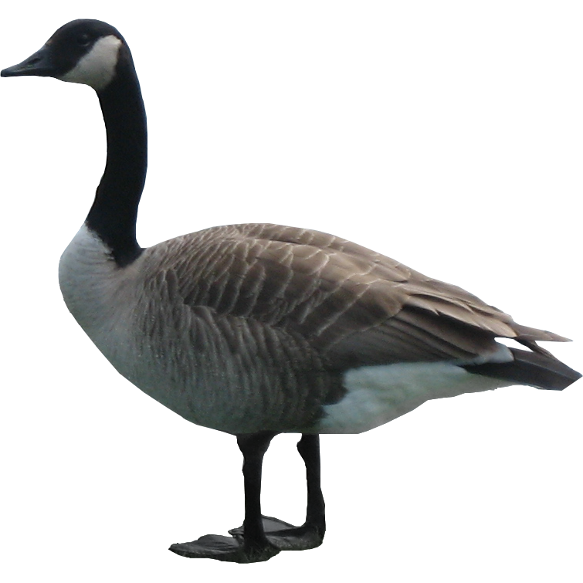
Lack of Inductive Biases
Inductive Biases are analysis priors, influenced by the structure of the model
Transformers lack inductive biases found in CNNs such as Translational Equivariance
Advantages
Isn’t restricted to a specific way of analysis
Performs scales very well with more data
Disadvantages
Poor performance on mid-sized datasets as it doesn’t have enough examples to learn from

